Slide 1

Cyclistic Bike-Share Analysis
How Do Annual Members and Casual Riders Use Cyclistic Bikes Differently?
Google Data Analytics Case Study | Behavioral & Marketing Analytics Project
Tools: Python | Pandas | Matplotlib | Seaborn
YOUSEF ABOSHOSHA

Slide 2
Business Problem
Cyclistic is a Chicago bike-share program with 5,800+ bicycles and 600+ docking stations. Annual members are significantly more profitable than casual riders.
Key Business Question
Business Goal
Strategic Objective
How do annual members and casual riders use Cyclistic bikes differently?
Identify behavioral patterns that can help convert casual riders into annual members.
Design marketing strategies aimed at converting casual riders into annual members.
Key Insight: Casual riders are already aware of Cyclistic and have chosen it for their mobility needs — making them prime candidates for membership conversion.
02

Slide 3
Dataset Overview
5.5M+
12
21
5.8K+
Total Rides Analyzed
Months of Data
Data Columns
Bicycles in Fleet
Key Features
Engineered Features
■ Ride timestamps (start/end)
■ Ride duration (minutes)
■ Bike type (classic/electric)
■ Station information
■ Rider category (member/casual)
■ Geographic coordinates
■ ride_length_min
■ day_of_week / is_weekend
■ season / month
■ hour / time_period
■ is_round_trip
Source: Motivate International Inc. public bike-share data (12-month period)
03

Slide 4
Data Cleaning & Feature Engineering
Data Processing Steps
Features Engineered
01
Removed invalid ride durations (negative or zero values)
Feature | Description
ride_length_min | Ride duration in minutes
day_of_week | Day name (Monday-Sunday)
season | Spring / Summer / Fall / Winter
time_period | Morning / Afternoon / Evening / Night
is_weekend | Boolean weekend flag
02
Converted datetime columns to proper timestamp format
03
Handled missing station name and ID values
04
Removed duplicate ride records
05
Standardized column names across all 12 monthly files
Tech Stack: Python | Pandas (data manipulation) | Matplotlib & Seaborn (visualization) | Jupyter Notebook
04

Slide 5
Casual Riders Take Significantly Longer Trips
CASUAL RIDERS
ANNUAL MEMBERS
DIFFERENCE
23.35 min
12.69 min
+84% longer
Average ride duration
Average ride duration
Casual vs. Member rides
Business Interpretation
Members use bikes for transportation — short, purposeful trips with a clear destination.
Casual riders use bikes recreationally — longer, leisure-focused trips exploring the city.
The 84% duration gap is the strongest behavioral differentiator between the two groups.
05

Slide 6
Members Dominate Weekdays; Casual Riders Peak on Weekends
MEMBERS
76.9%
Weekday rides — commuting behavior
23.1%
Weekend rides — leisure use
CASUAL RIDERS
63.0%
Weekday rides — mixed use
37.0%
Weekend rides — recreational focus
Key Takeaway: The weekday/weekend split is a strong indicator of commuting vs. recreational usage — members ride to work; casual riders ride for fun.
06

Slide 7
Members Show Clear Rush-Hour Riding Patterns
Member Peak: 7-9 AM and 4-6 PM — classic commute hours
Casual Peak: 12-6 PM — midday leisure activity
Cyclistic bikes are integrated into members' daily transportation routine, while casual riders treat biking as a recreational activity.
07

Slide 8
Casual Riders Show Strong Seasonal Usage Patterns
Seasonal Breakdown
SUMMER
913K
Highest casual ridership — peak recreational season
WINTER
91K
Lowest casual ridership — 10x decrease from summer
Members ride consistently year-round, resilient to weather changes.
Business Insight: Casual usage is highly weather-dependent. Summer represents the highest opportunity window for membership conversion campaigns.
08

Slide 9
Casual Riders Take More Round Trips
ROUND-TRIP RATE
15.47%
9.75%
Casual riders
Annual members
Top Casual Rider Stations
# | Station Name | Rides
1 | Navy Pier | 32,221
2 | DuSable Lake Shore Dr & Monroe St | 31,175
3 | Michigan Ave & Oak St | 22,325
4 | DuSable Lake Shore Dr & North Blvd | 19,319
Interpretation: Round trips and tourist-area stations suggest casual riders use bikes for sightseeing, exploration, and recreational discovery — not point-to-point commuting.
09

Slide 10
Behavioral Profiles Summary
Annual Members
Casual Riders
■ Weekday usage (76.9%)
■ Rush-hour activity (7-9 AM, 4-6 PM)
■ Shorter rides (12.7 min average)
■ Commuting behavior
■ Consistent year-round usage
■ One-way trips (90.3%)
■ Business district stations
■ Weekend usage (37.0%)
■ Midday activity (12-6 PM)
■ Longer rides (23.3 min average)
■ Recreational behavior
■ Seasonal activity (summer peak)
■ Round trips (15.5%)
■ Tourist area stations
The two rider types demonstrate fundamentally different use cases for the same service — transportation vs. recreation.
10

Slide 11
Strategic Recommendations
1
Weekend Membership Campaigns
2
Target Casual Commuters
Target recreational riders with weekend-focused offers, family plans, and leisure-oriented membership benefits.
Find commuter-like casual riders and promote membership savings over per-ride costs.
3
Seasonal Promotions
4
Station-Based Advertising
Increase marketing during high-demand summer periods when casual ridership peaks and conversion intent is highest.
Place membership promotions at high casual-rider stations: Navy Pier, Lake Shore Dr, and Michigan Ave corridor.
Implementation Priority Matrix
Recommendation | Priority | Target Segment | Expected Impact
Seasonal Promotions | High | Summer casual riders | High volume conversion
Station-Based Ads | High | Tourist riders | Targeted reach
Weekend Campaigns | Medium | Leisure riders | Loyalty building
11

Slide 12
Expected Business Impact
Increased Annual Memberships
Improved Rider Retention
Targeted conversion campaigns based on behavioral insights can convert high-value casual riders into recurring annual members.
Matching membership benefits to actual usage patterns increases satisfaction and reduces churn among converted members.
Better Customer Segmentation
More Efficient Marketing
Clear behavioral profiles enable precise audience targeting and personalized marketing messaging for each rider segment.
Station and season-based targeting reduces wasted ad spend and improves campaign ROI through data-driven placement.
10%
Converting just 10% of casual riders to annual memberships could generate significant recurring revenue, given that members are proven to be more profitable than casual riders.
Conversion target
12

Slide 13
Conclusion
MAIN FINDING
Members primarily use bikes for commuting — short weekday trips during rush hours.
Casual riders use bikes for recreation — longer weekend trips in warmer months.
Key Evidence Summary
84%
77%
10x
15.5%
Longer casual rides vs. member rides
Member weekday usage rate
Summer-to-winter casual drop
Casual round-trip rate
Strategic Opportunity: Cyclistic can increase memberships by targeting high-value casual riders with behavior-based marketing campaigns informed by these clear usage patterns.
13

Slide 14
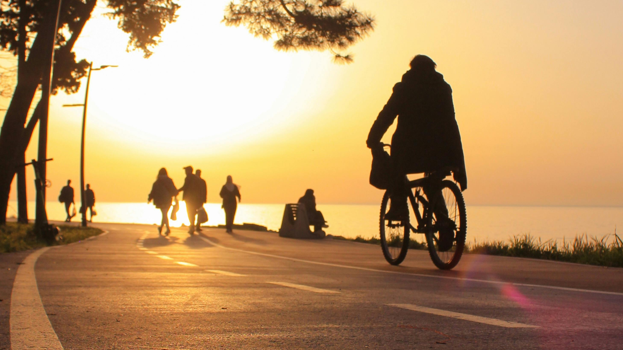
Thank You
PYTHON | PANDAS | BEHAVIORAL ANALYTICS | MARKETING ANALYTICS

